Slide 1


The Fourth Industrial Revolution
How Technology is changing lives and careers

Slide 2
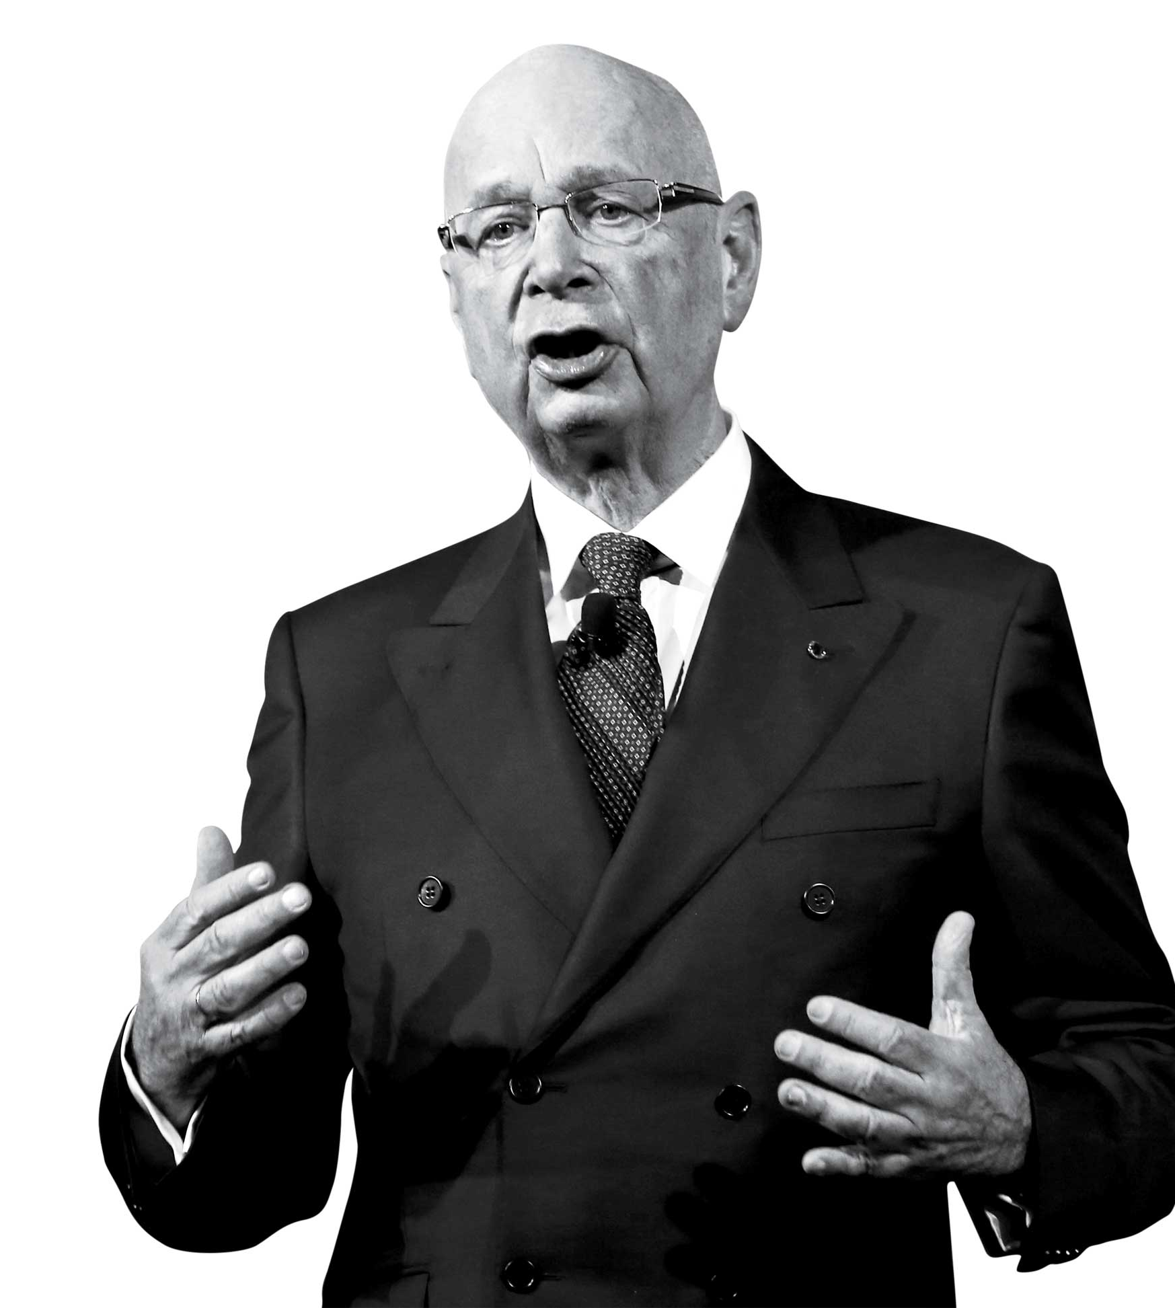
We stand on the brink of a technological revolution that will fundamentally alter the way we live, work, and relate to one another. In its scale, scope, and complexity, the transformation will be unlike anything humankind has experienced before. We do not yet know just how it will unfold, but one thing is clear: the response to it must be integrated and comprehensive, involving all stakeholders of the global polity, from the public and private sectors to academia and civil society.
Klaus Schwab - Founder and Executive Chairman, World Economic Forum

Slide 3

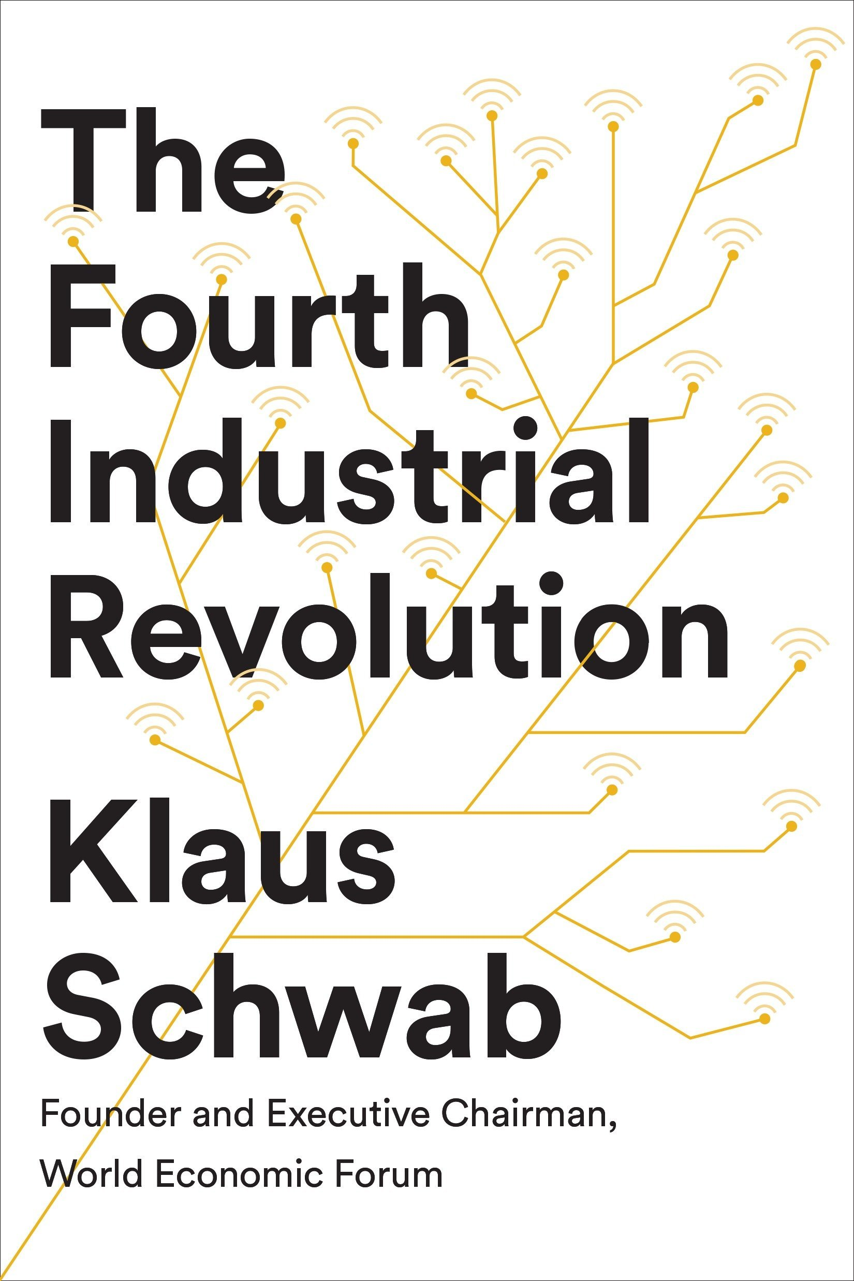
What is the Fourth Industrial Revolution?
Didn’t we do that already?

Slide 4

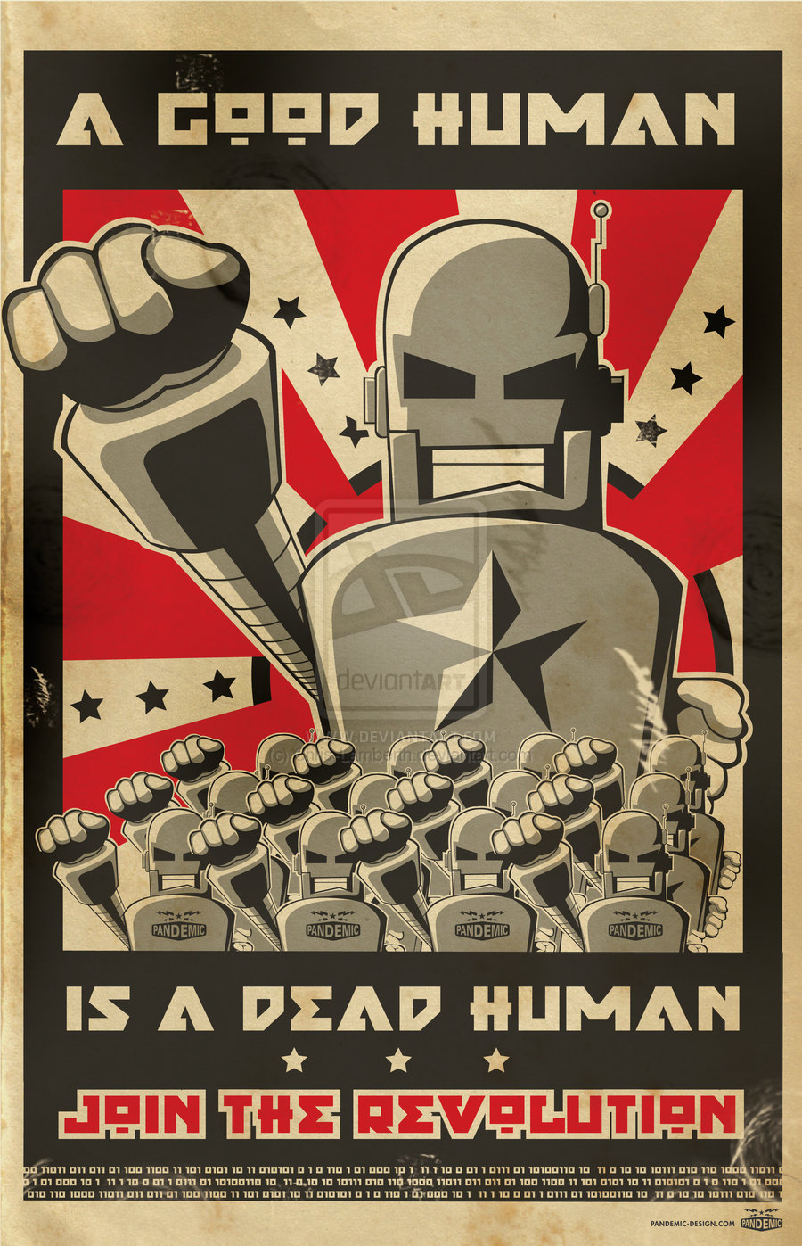
Define: Industrial Revolution
revolution
noun [ C ]
/ˌrevəlˈuːʃən/
a big change or improvement in the way that something works or looks, or in the way that people do a particular activity:
a revolution in sth Facing up to climate change requires a revolution in business thinking.
an economic/technological/green revolution
the digital/internet/IT revolution
This Photo by Unknown Author is licensed under CC BY-NC-ND

Slide 5
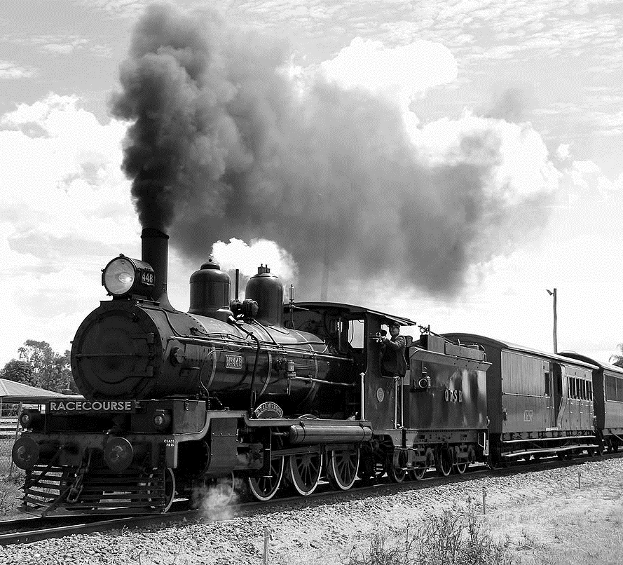
1760 - The First Industrial Revolution
The Age of Mechanical Production
Society shifts from agrarian to urbanised
Steam becomes mainstream
Steam power
Steam ships
Steam trains
The dawn of factories
Child Labour
14-hour shifts
Cities and industry begins to grow
This Photo by Unknown Author is licensed under CC BY-SA

Slide 6
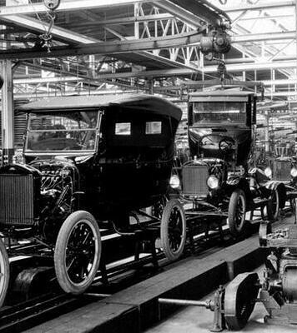
1900 - The Second Industrial Revolution
The Age of Science and Mass Production
Advances speed up
Airplanes
Gasoline engines
Chemical Fertiliser
Factories change
Birth of the ‘assembly line’
Electricity, radio, & telephone transform communication
In 1900, 40% of the US live in cities compared to the 6% of 1800
This Photo by Unknown Author is licensed under CC BY

Slide 7
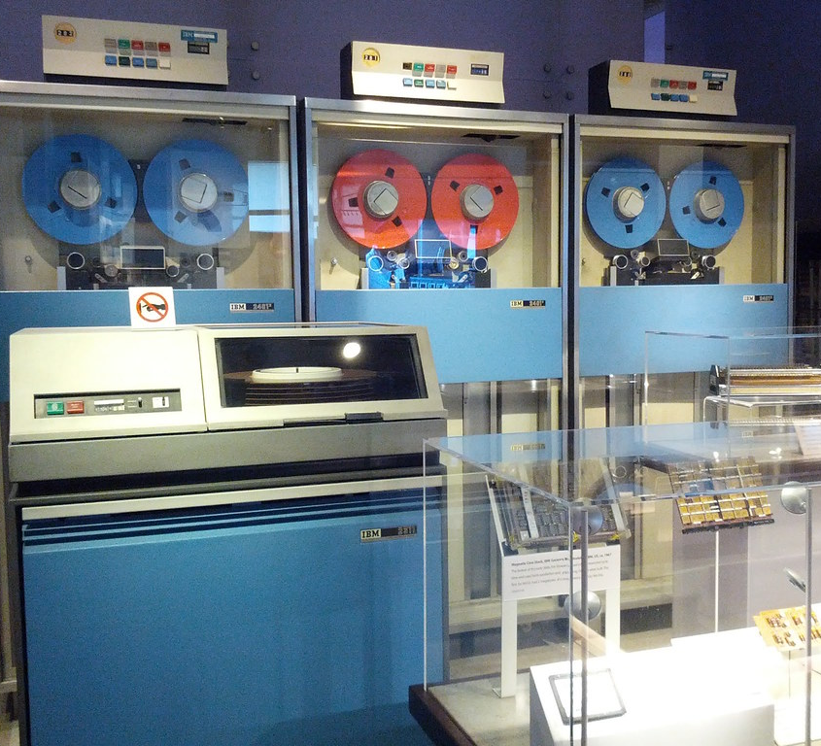
1950 - The Third Industrial Revolution
The Digital Revolution
Computing becomes a thing
Semiconductors
Mainframe computing
Personal computing
The internet
Technology takes us to the moon
The move from analogue to digital
Connectivity and work automation take hold
This Photo by Unknown Author is licensed under CC BY

Slide 8
Define: Industrial revolution
Each of these first three industrial revolutions represented profound change
We’re talking major societal transformation.
Life went from being all about the farm to all about the factory, and people moved from the country into town with the introduction of mechanical production.
How people lived and worked fundamentally changed with the discovery of electricity and mass production.
And most recently, the digital revolution altered nearly every industry, once again transforming how people live, work, and communicate.
This Photo by Unknown Author is licensed under CC BY-NC-ND

Slide 9

So where are we now?

Slide 10
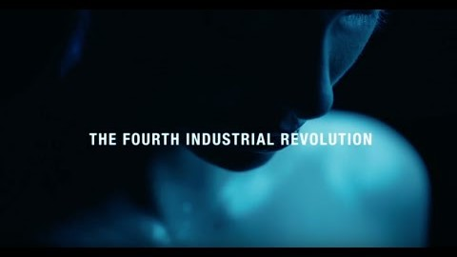

Slide 11
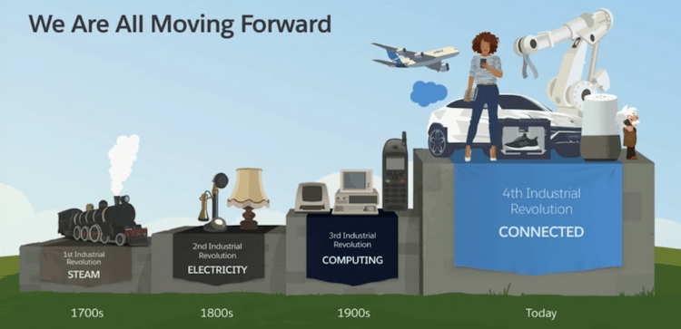
The fourth Industrial Revolution

Slide 12
The Fourth Industrial Revolution
The Fourth Industrial Revolution is a way of describing the blurring of boundaries between the physical, digital, and biological worlds.
It’s a fusion of advances in artificial intelligence (AI), robotics, the Internet of Things (IoT), 3D printing, genetic engineering, quantum computing, and other technologies.
It’s the collective force behind many products and services that are fast becoming indispensable to modern life.
Think GPS systems that suggest the fastest route to a destination, voice-activated virtual assistants such as Apple’s Siri, personalized Netflix recommendations, and Facebook’s ability to recognize your face and tag you in a friend’s photo.
https://www.salesforce.com/blog/2018/12/what-is-the-fourth-industrial-revolution-4IR.html

Slide 13
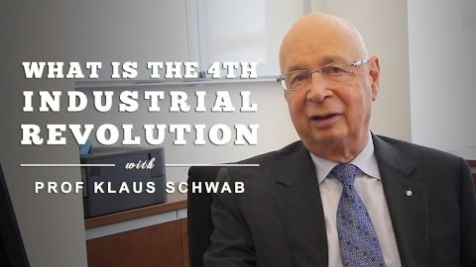

Slide 14
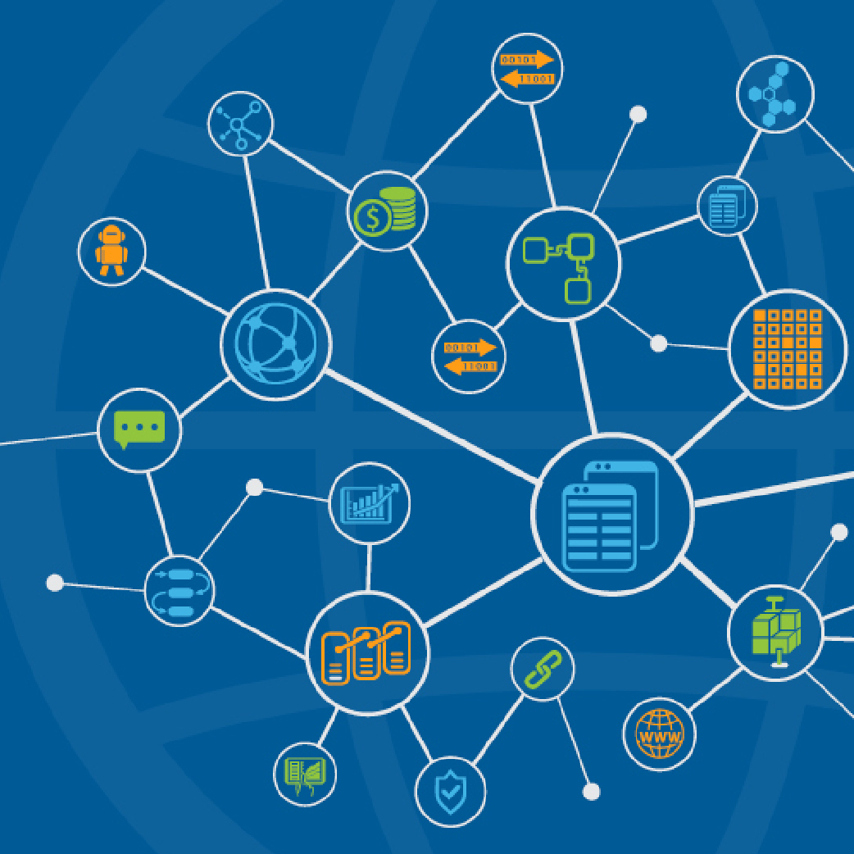
What are the technologies driving change?
Artificial intelligence (AI) describes computers that can “think” like humans — recognizing complex patterns, processing information, drawing conclusions, and making recommendations. AI is used in many ways, from spotting patterns in huge piles of unstructured data to powering the autocorrect on your phone.
Blockchain is a secure, decentralized, and transparent way of recording and sharing data, with no need to rely on third-party intermediaries. The digital currency Bitcoin is the best known blockchain application. However, the technology can be used in other ways, including making supply chains traceable, securing sensitive medical data anonymously, and combating voter fraud.
This Photo by Unknown Author is licensed under CC BY-NC-ND

Slide 15
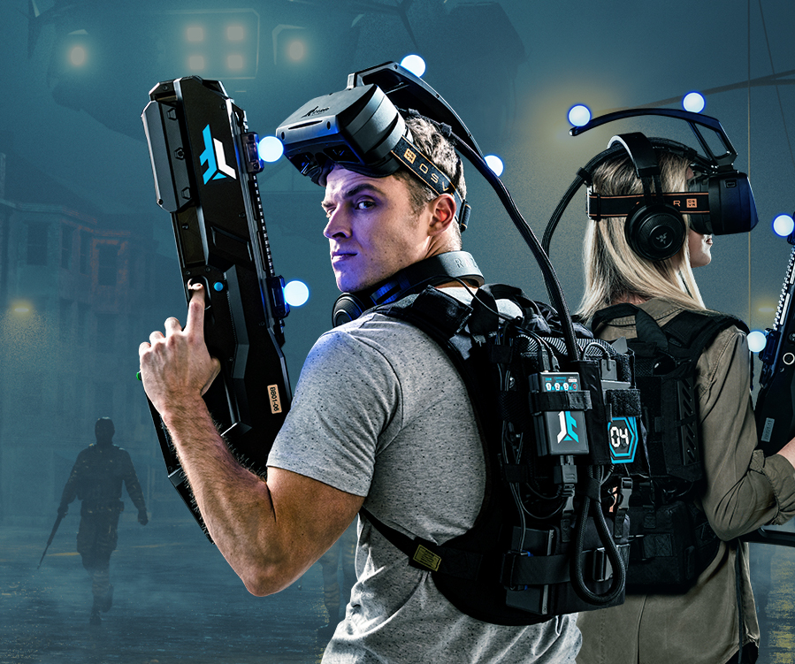

What are the technologies driving change?
New computational technologies are making computers smarter. They enable computers to process vast amounts of data faster than ever before, while the advent of the “cloud” has allowed businesses to safely store and access their information from anywhere with internet access, at any time. Quantum computing technologies now in development will eventually make computers millions of times more powerful. These computers will have the potential to supercharge AI, create highly complex data models in seconds, and speed up the discovery of new materials.
Virtual reality (VR) offers immersive digital experiences (using a VR headset) that simulate the real world, while augmented reality merges the digital and physical worlds. Examples include L’Oréal’s makeup app, which allows users to digitally experiment with makeup products before buying them, and the Google Translate phone app, which allows users to scan and instantly translate street signs, menus, and other text.
This Photo by Unknown Author is licensed under CC BY-SA-NC

Slide 16
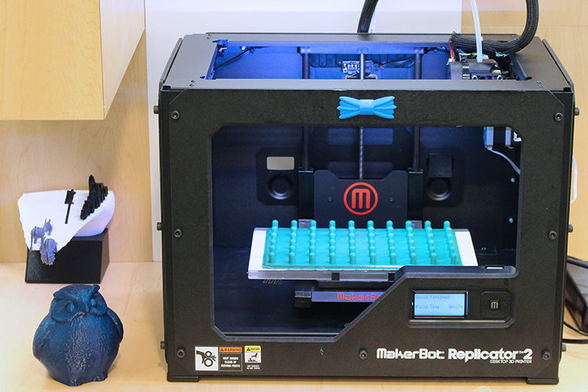
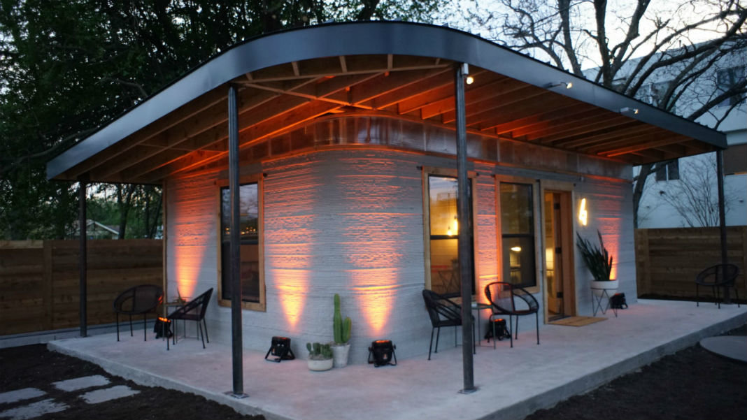
What are the technologies driving change?
3D printing allows manufacturing businesses to print their own parts, with less tooling, at a lower cost, and faster than via traditional processes. Plus, designs can be customized to ensure a perfect fit.
Innovative materials, including plastics, metal alloys, and biomaterials, promise to shake up sectors including manufacturing, renewable energy, construction, and healthcare.

Slide 17
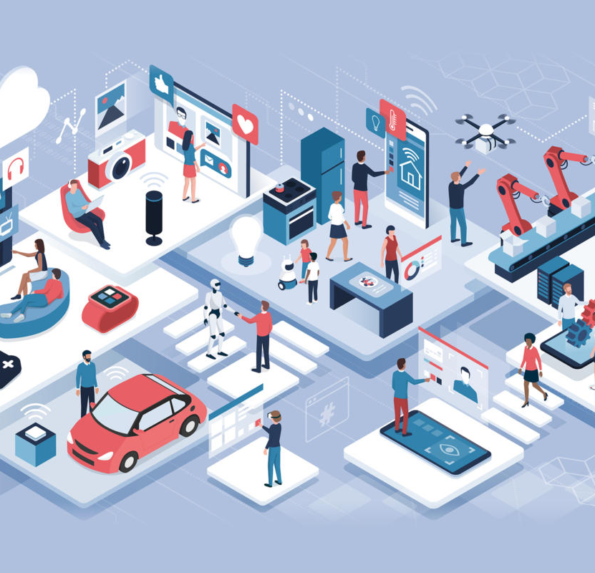
What are the technologies driving change?
The IoT describes the idea of everyday items — from medical wearables that monitor users’ physical condition to cars and tracking devices inserted into parcels — being connected to the internet and identifiable by other devices. A big plus for businesses is that they can collect customer data from constantly connected products, allowing them to better gauge how customers use products and tailor marketing campaigns accordingly. There are also many industrial applications, such as farmers putting IoT sensors into fields to monitor soil attributes and inform decisions such as when to fertilize.
Energy capture, storage, and transmission represent a growing market sector, spurred by the falling cost of renewable energy technologies and improvements in battery storage capacity.

Slide 18
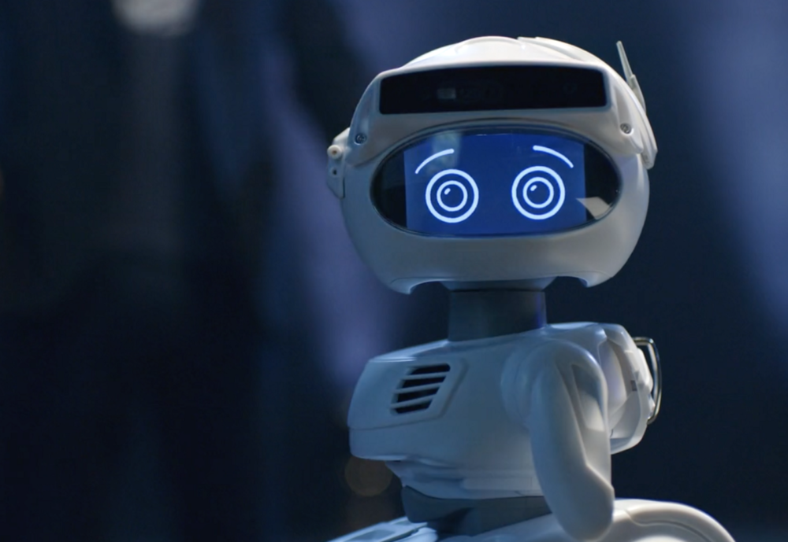
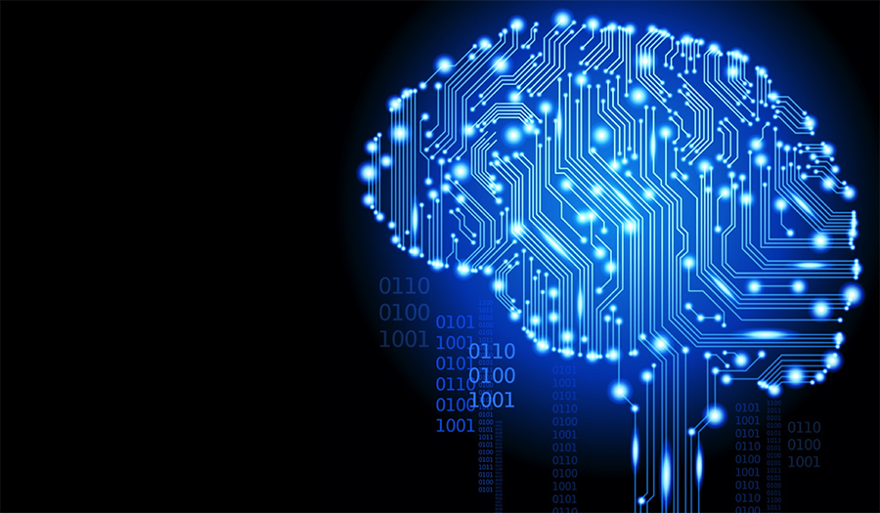
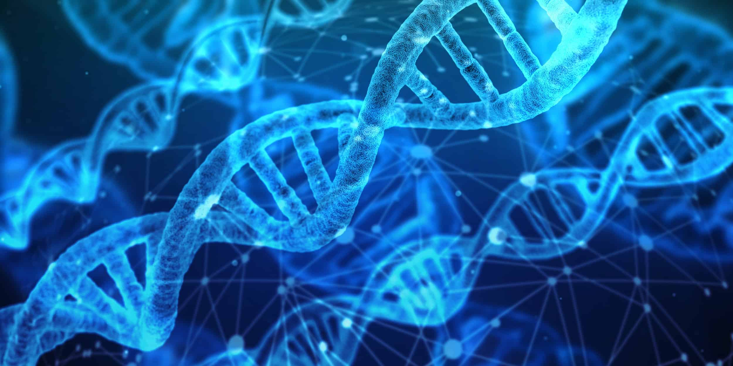
What are the technologies driving change?
Biotechnology harnesses cellular and biomolecular processes to develop new technologies and products for a range of uses, including developing new pharmaceuticals and materials, more efficient industrial manufacturing processes, and cleaner, more efficient energy sources. Researchers in Stockholm, for example, are working on what is being touted as the strongest biomaterial ever produced.
Robotics refers to the design, manufacture, and use of robots for personal and commercial use. While we’re yet to see robot assistants in every home, technological advances have made robots increasingly complex and sophisticated. They are used in fields as wide-ranging as manufacturing, health and safety, and human assistance.

Slide 19
Emerging Tech Today
AI and AGI: Tools like ChatGPT and Gemini are transforming communication, research, and creativity.
Robotics: Boston Dynamics’ Spot, Tesla Optimus Gen 2 in manufacturing.
Quantum Computing: IBM/Google achieving narrow-use quantum advantage.
Biotech: CRISPR treatments approved in 2024.
Digital Twins & IoT: Real-time monitoring in mining and aviation.
AI + Creativity: Adobe Firefly, DALL·E, AI music/video generation.

Slide 20
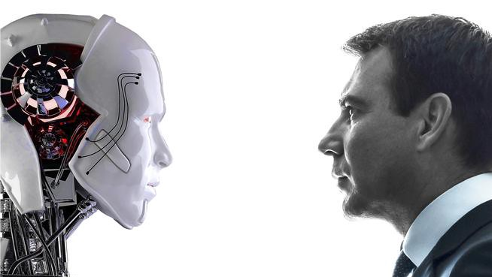
Humans Need not Apply
Beep Boop Beep Beep Boop

Slide 21
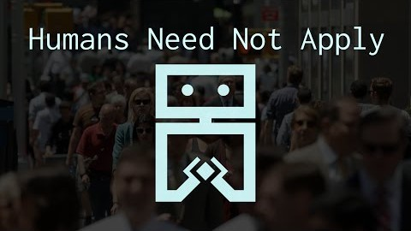

Slide 22

Automation is here

Slide 23
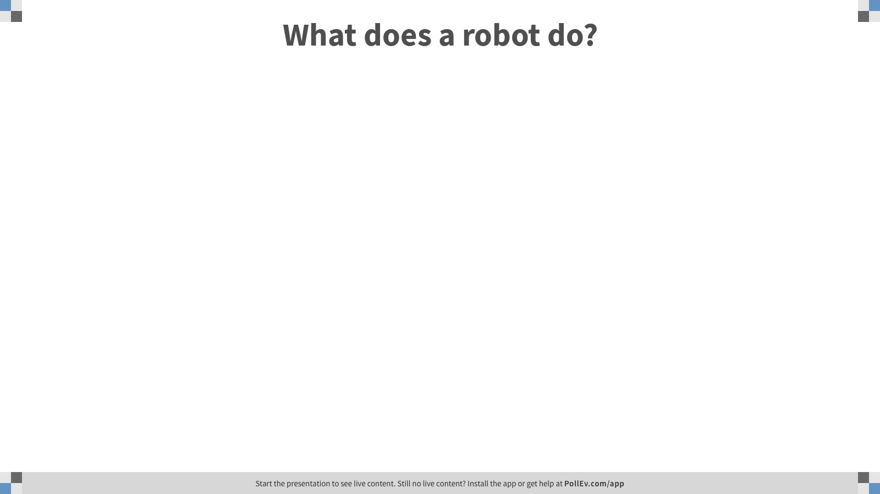
Notes:
Poll Title: What does a robot do? https://www.polleverywhere.com/free_text_polls/APPNVeSyWG1y12xx0JBTn

Slide 24
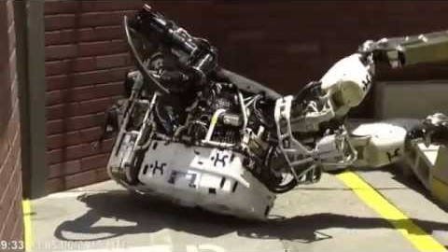
2015 – DARPA Robotics Challenge

Slide 25
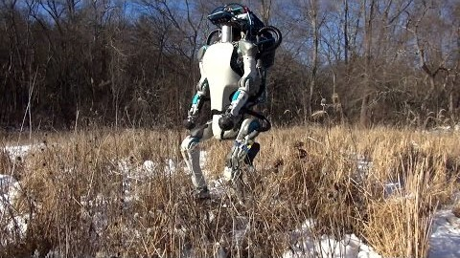
2016 – One year later

Slide 26
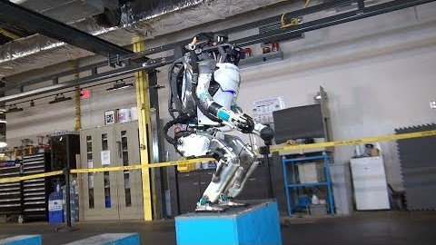
2017…

Slide 27
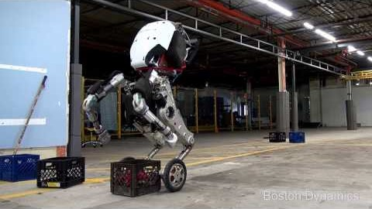
2017…

Slide 28
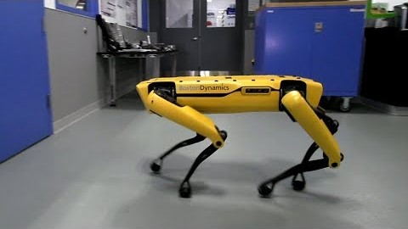
2018…

Slide 29
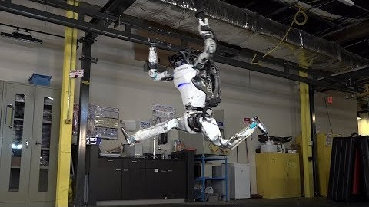
2019…

Slide 30
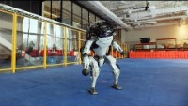
2020…

Slide 31
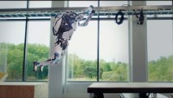
2021…

Slide 32
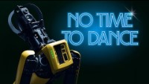
Dancing Robots

Slide 33
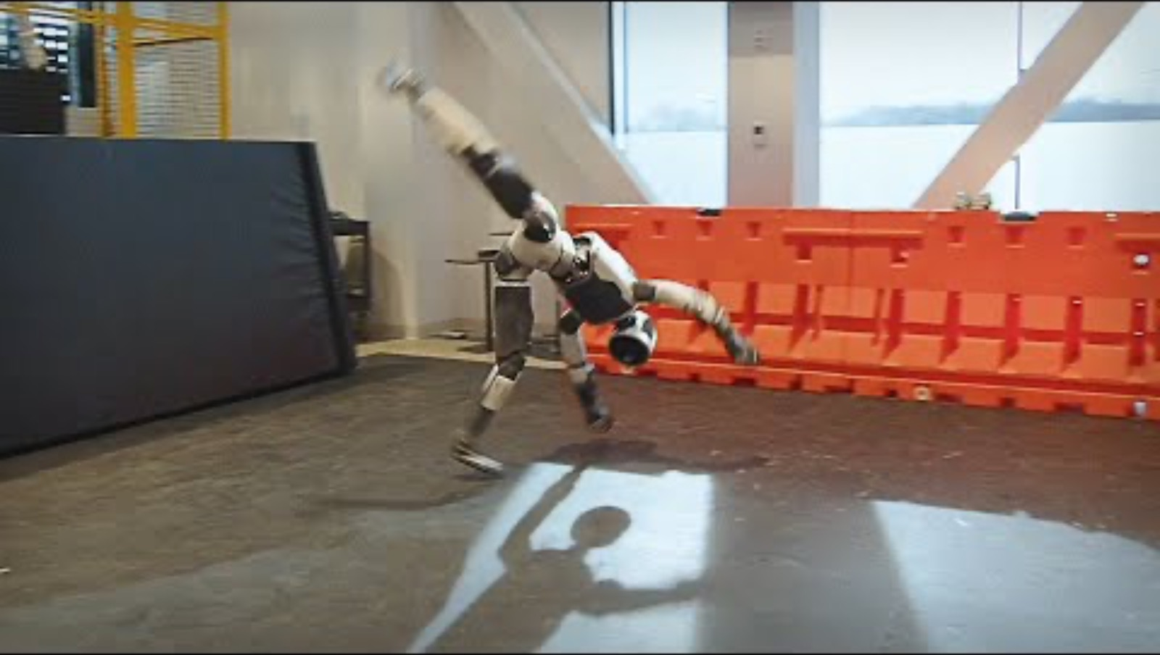
Walk, Run, Crawl, RL Fun – Atlas 2025

Slide 34
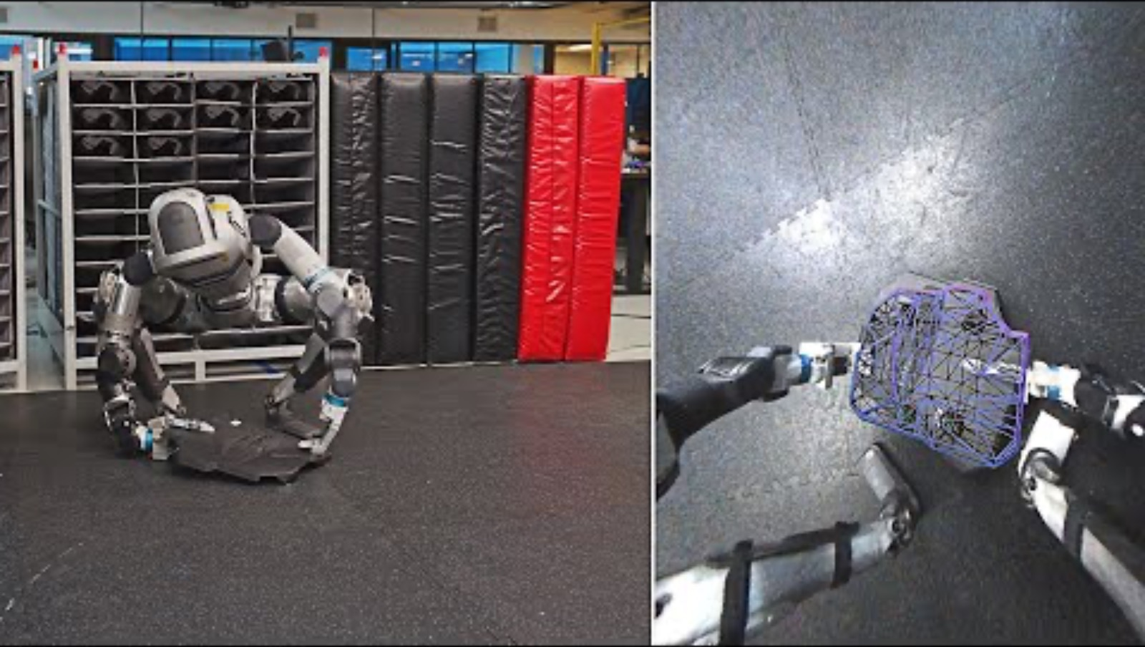
1 Month Ago - Perception And Adaptability

Slide 35
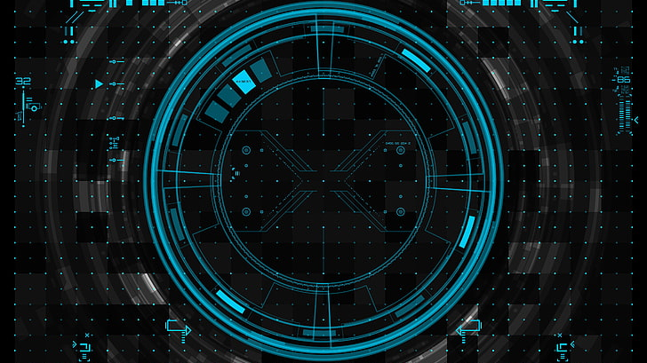
What would be Next!

Slide 36

Dr. Li Jiang Director of Stanford AIRE
Dr. Li Jiang is the Director of Stanford AIRE (AI, Robotics and Education). Dr. Jiang has been doing research in the field of Robotics and AI for many years. He was the top award: “Best of Innovations” award winner for 2014 Consumer Electronics Show (CES) Innovation Awards and the top award: “Best of the Program Award” winner of National Lincoln Design Competition. He also served as a Judge in the Judging Committee for the CES Innovation award. His current research focuses on how AI and Robotic technologies will impact our education system and how we need to adjust our education system to accommodate the coming era of Robotics and AI. His class “AI, Robotics and Design of Future Education” is the first class at Stanford University to address this multidisciplinary field of AI, Robotics, Education and Design Innovation. Dr. Jiang holds more than 50 U.S and international patents. He holds a Master Degree on Design Innovation, a Ph.D on Robotics and a Ph.D minor on Management Science from Stanford University.

Slide 37
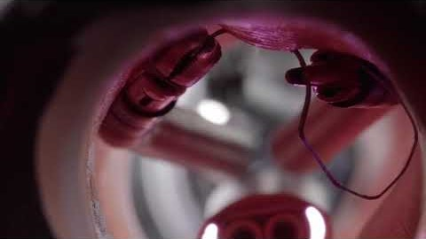
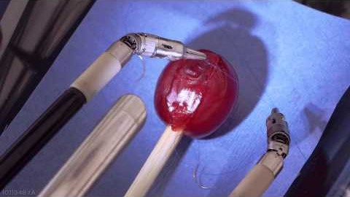
Da-Vinci Surgical Robot

Slide 38
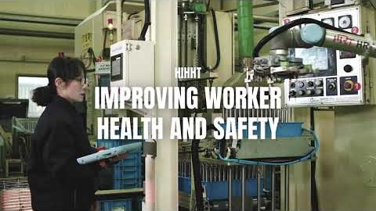
COBOTS – The General Robot for all our Needs

Slide 39
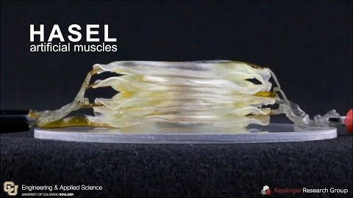
Artificial Muscles – Mimicking Human Muscle

Slide 40
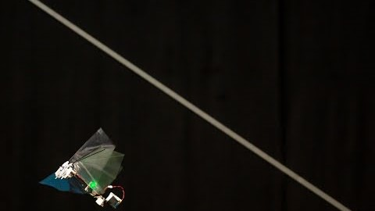
DelFly Nimble – Insect-like robots on the small scale

Slide 41
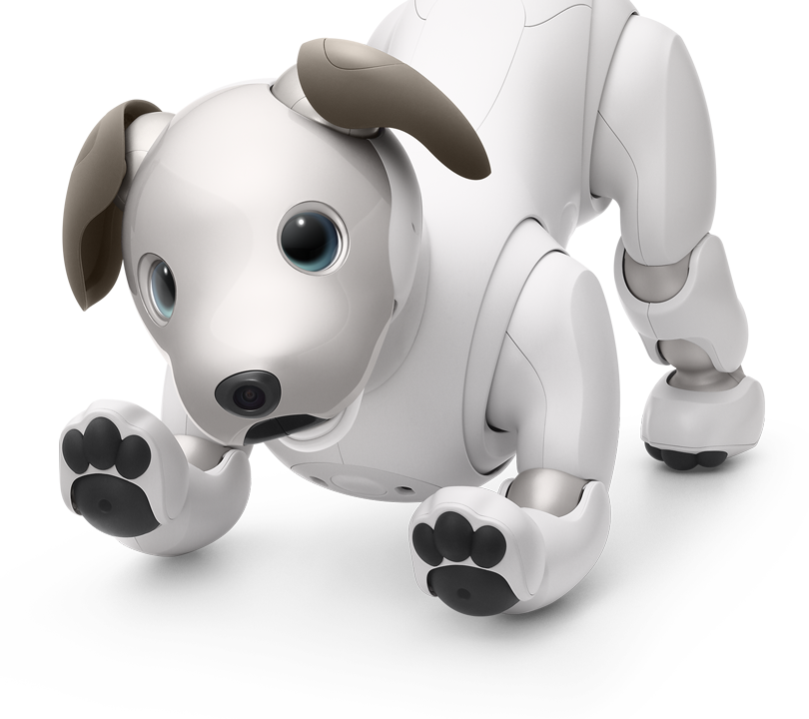
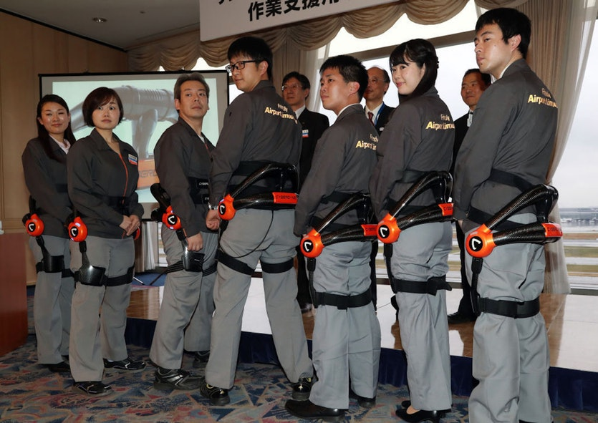
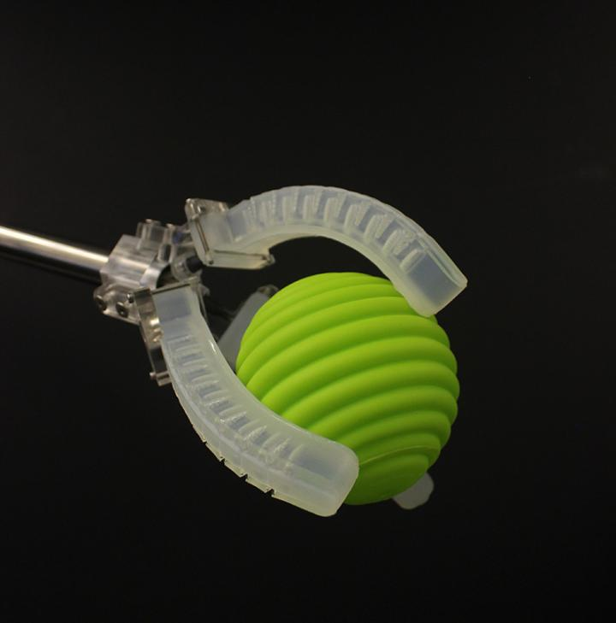
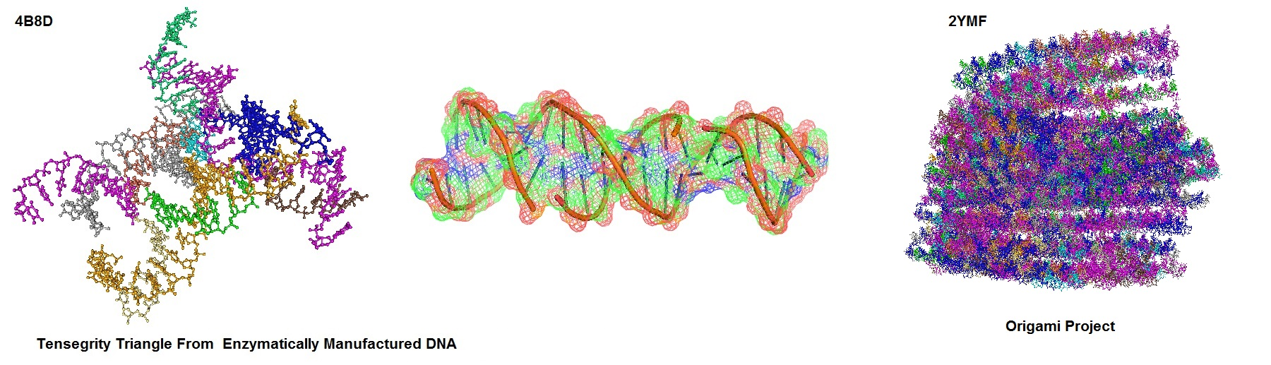
But Wait, There’s More!
3D-Printed robotic skin
Soft-Exo suits
Sony’s AIBO
DNA origami
https://cosmosmagazine.com/technology/the-10-most-exciting-robotics-developments-of-the-past-12-months
And there’s more everyday!

Slide 42
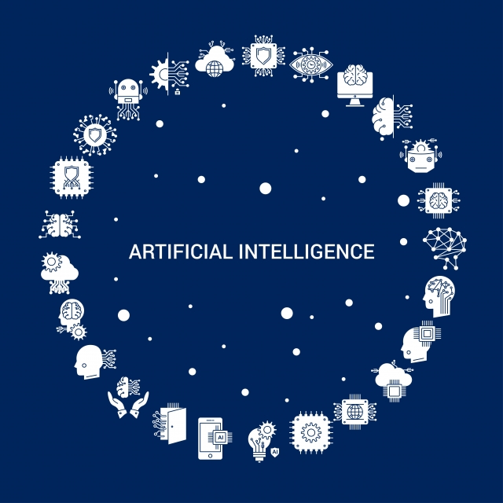
A quick look at AI

Slide 43
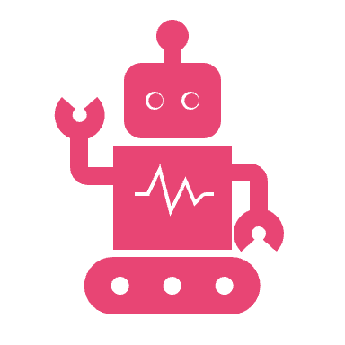
What is Artificial Intelligence?
While AI is generally synonymous with artificial intelligence, more technically sophisticated systems can be described as “artificial general intelligence”. These systems are able to solve problems that are very different from those that can be solved with a machine, in an extremely fast and scalable fashion.
Since computer hardware has continued to improve to become incredibly efficient and powerful, many companies have sought to improve on machine learning capabilities — in the form of neural networks. Neural networks are simply algorithms that train one another by combining their experience to perform many different tasks.

Slide 44
What is machine learning?
The first good example of machine learning was teaching artificial neural networks on how to recognize faces in a database.
Many more applications include the way we understand texts online and what a person writes on a piece of paper. AI can learn in an almost infinite variety of scenarios and situations.
Machine thinking is a term applied to machines that can learn from information.
The term uses the idea of “learning from mistakes”, meaning machines can use data to avoid or learn from mistakes, such as when a user is looking at a website and the image they see is not the perfect image, or when a human reads text and sees a spelling mistake.

Slide 45
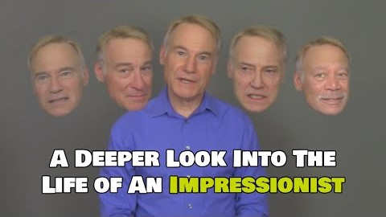
A Look at Machine Learning in Action

Slide 46
What is Deep Learning?
Deep Learning is a general-purpose, AI-based computer method of classifying a data set as containing “interesting” or “uninteresting” features and producing a training algorithm that can be applied to specific examples.
The machine learns to do math and physics by itself. It learns every bit about the material and the data it looks at.
Deep neural networks can produce stunning results; they can find hidden patterns in data by learning, say, to identify the frequency of one or two letters in a text. This is called backpropagation and takes away a lot of human work thanks to AI technology.

Slide 47
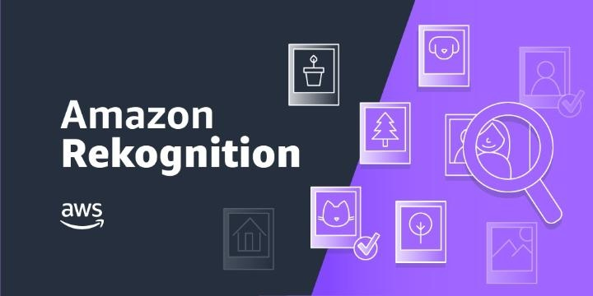
AI used Right NOW in Business
Amazon
Amazon’s machine learning system Rekognition, which it sells to advertising and marketing companies, but it also sells Rekognition to police forces, immigration services, and others looking to keep an eye on the ‘bad guys’.
https://aws.amazon.com/rekognition/

Slide 48

AI used Right NOW in Business
John Deere
One application of Blue River’s technology has been in the development of Deere’s See and Spray pesticide and herbicide distribution systems. This involves using smart cameras powered by computer vision, which can distinguish between healthy and unhealthy crops as machinery passes through the field. While traditionally the decision about whether to dose a crop with chemicals has been made on a field-by-field basis, this system allows targeted bursts of chemicals to be directed precisely where they are needed, at individual plants – hence the 80 to 90% reduction in herbicide use touted above.
More cameras monitor the detritus from the harvesting operation – stalks, leaves, and cobs – as they are ejected from the rear of the harvester to become fertilizer for the fields. These cameras check that no grains are being ejected – with the aim being to ensure zero wastage.

Slide 49


AI used Right NOW in Business
Stitch Fix
AI Powered personal shopping
Tailors size, fit, style and personal preferences based on a tailor-made profile and what items are kept from the service.

Slide 50
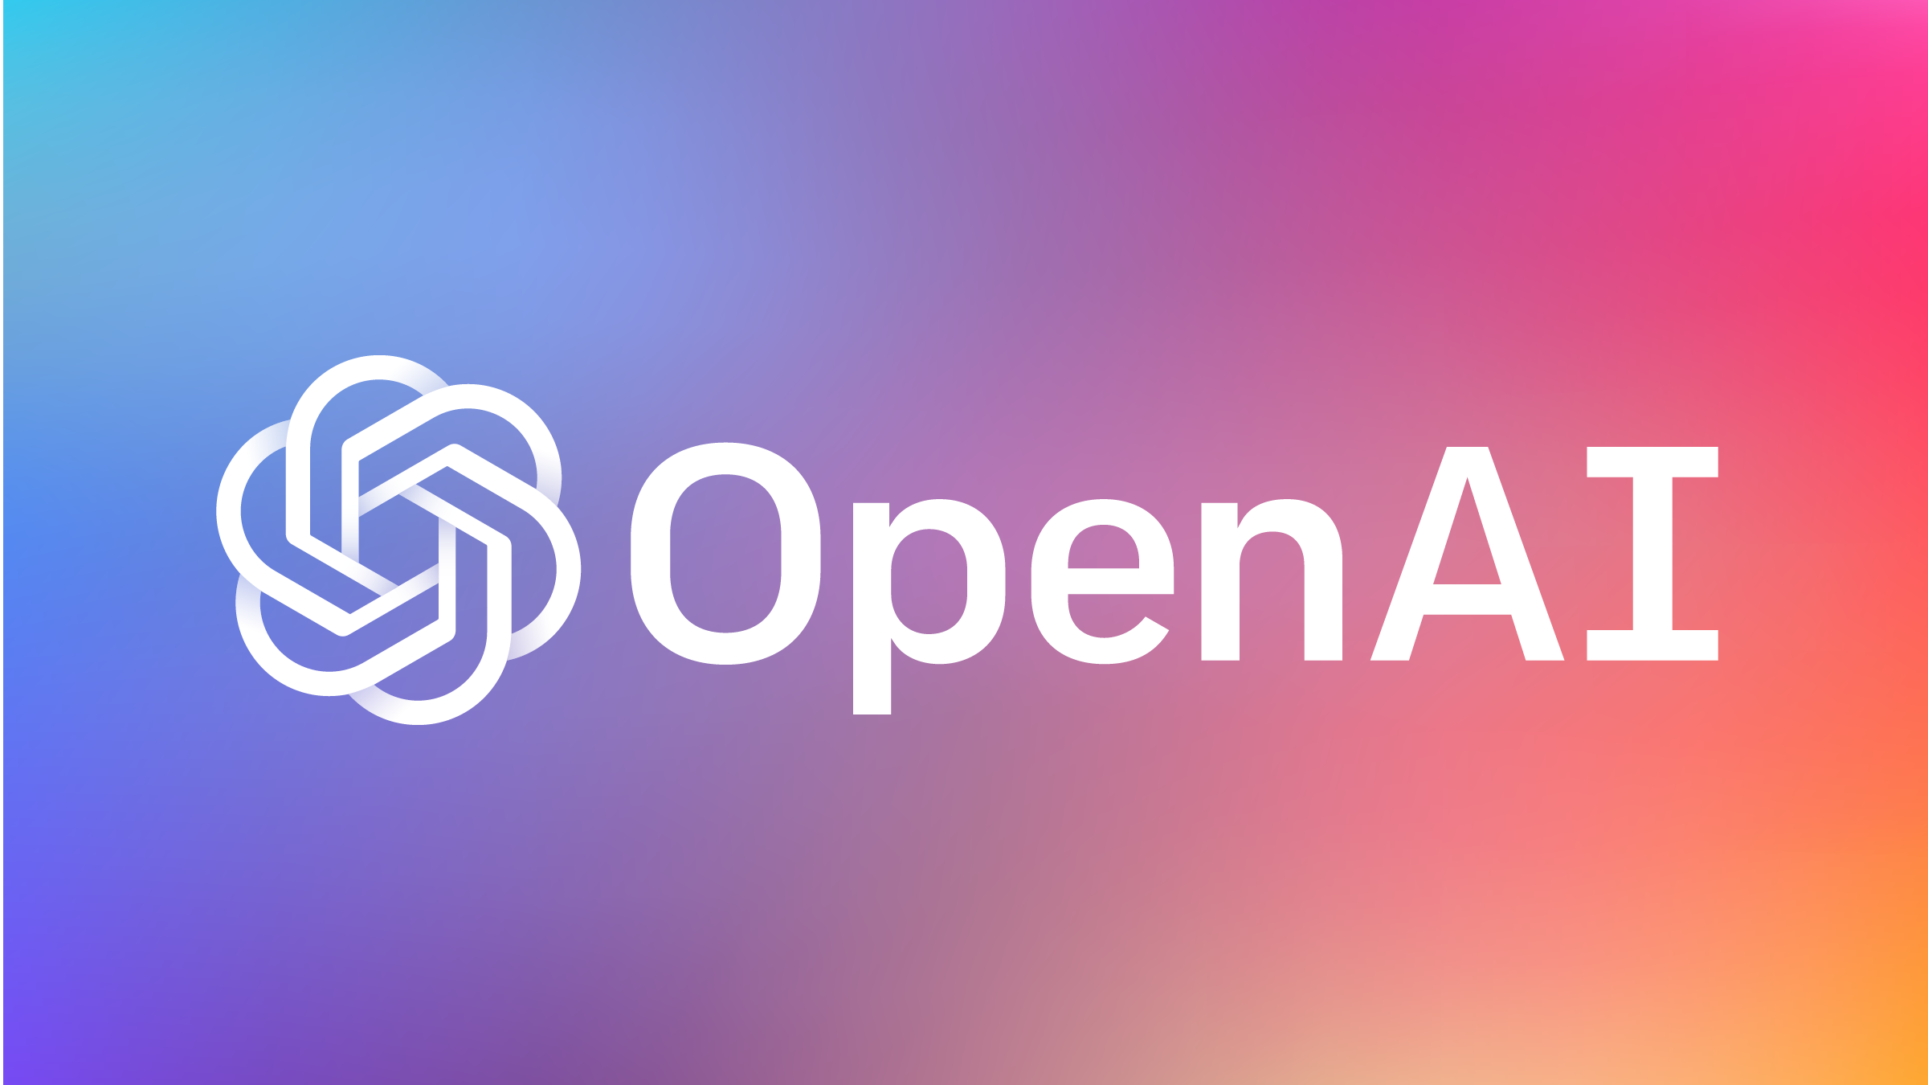
AI used Right NOW in Business
OpenAI
OpenAI’s mission is to ensure that artificial general intelligence (AGI)—by which we mean highly autonomous systems that outperform humans at most economically valuable work—benefits all of humanity. We will attempt to directly build safe and beneficial AGI, but will also consider our mission fulfilled if our work aids others to achieve this outcome.

Slide 51
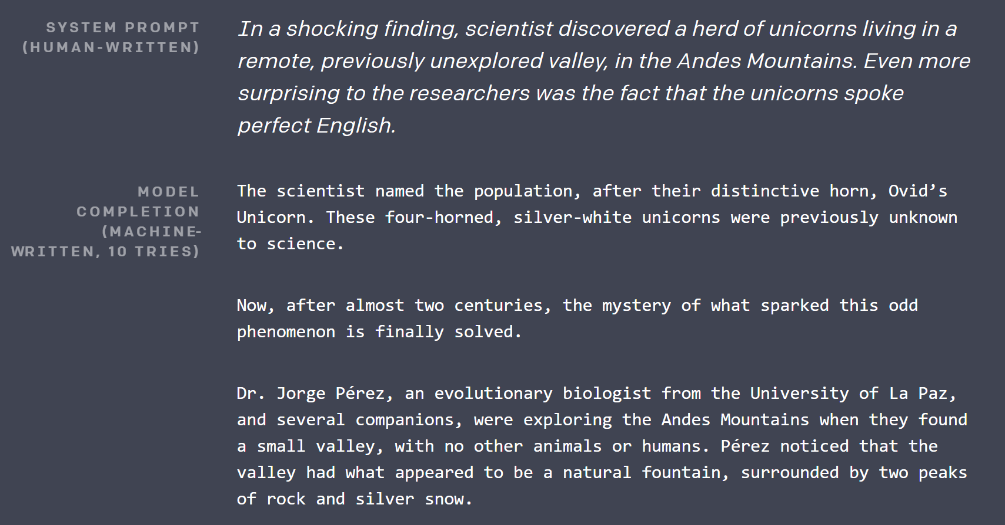
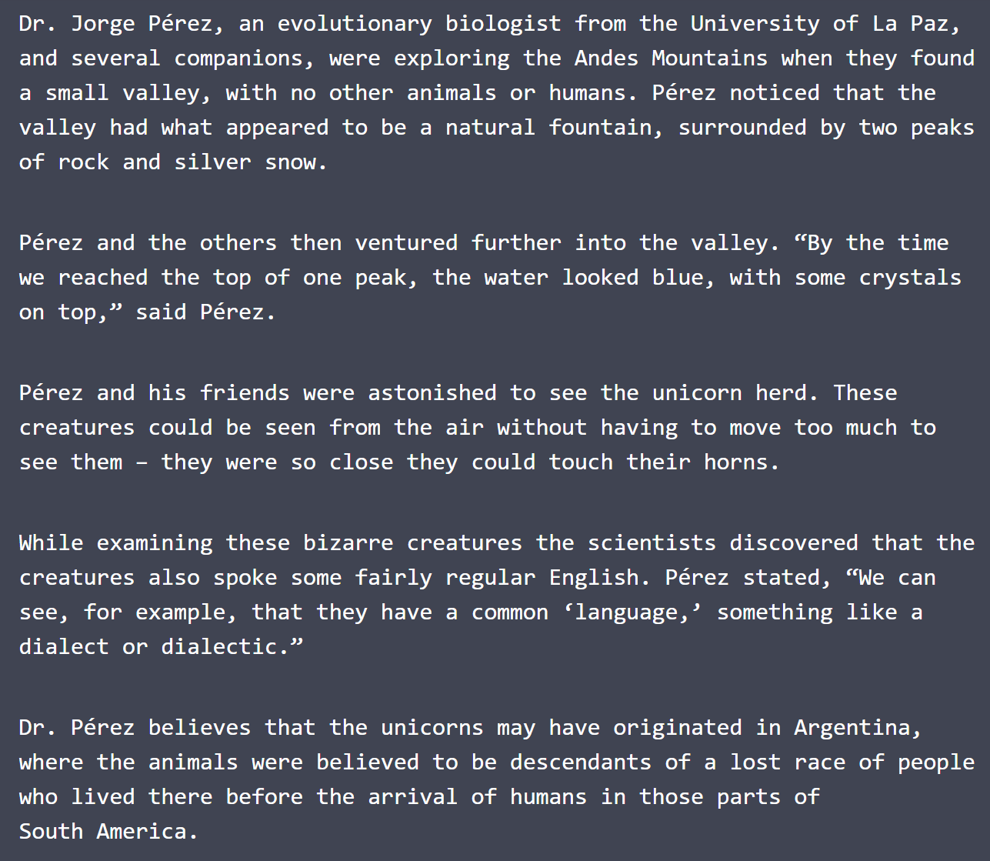
Open AI in Action

Slide 52
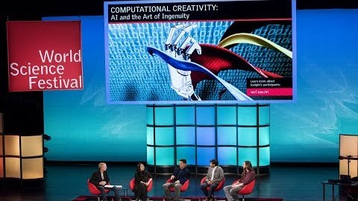
AI and Creativity

Slide 53
Application of Artificial Intelligence in Business
Improve customer services - eg use virtual assistant programs to provide real-time support to users (for example, with billing and other tasks).
Automate workloads - eg collect and analyse data from smart sensors, or use machine learning (ML) algorithms to categorise work, automatically route service requests, etc.
Optimise logistics - eg use AI-powered image recognition tools to monitor and optimise your infrastructure, plan transport routes, etc.
Increase manufacturing output and efficiency - eg automate production line by integrating industrial robots into your workflow and teaching them to perform labour-intensive or mundane tasks.
Prevent outages - eg use anomaly detection techniques to identify patterns that are likely to disrupt your business, such as an IT outage. Specific AI software may also help you to detect and deter security intrusions.
Predict performance - eg use AI applications to determine when you might reach performance goals, such as response time to help desk calls.
Predict behaviour - eg use ML algorithms to analyse patterns of online behaviour to, for example, serve tailored product offers, detect credit card fraud or target appropriate adverts.
Manage and analyse your data - eg AI can help you interpret and mine your data more efficiently than ever before and provide meaningful insight into your assets, your brand, staff or customers.
Improve your marketing and advertising - for example, effectively track user behaviour and automate many routine marketing tasks.

Slide 54
The TASK today…
Now that you have seen some forms of innovation, I want you to research different innovative technologies and conduct some research on them.
You will work in pairs for this task.
As a pair, you will identify a specific innovation or disruption of ICT / Technology in general and “become an expert” on the subject.
As a pair, over the next 3 weeks you will prepare a short presentation on your chosen topic and then answer questions by others in the class.
This will be worked on in class for the next 3 weeks and presentations will happen in week 4.

Slide 55

Questions

